Slide 1
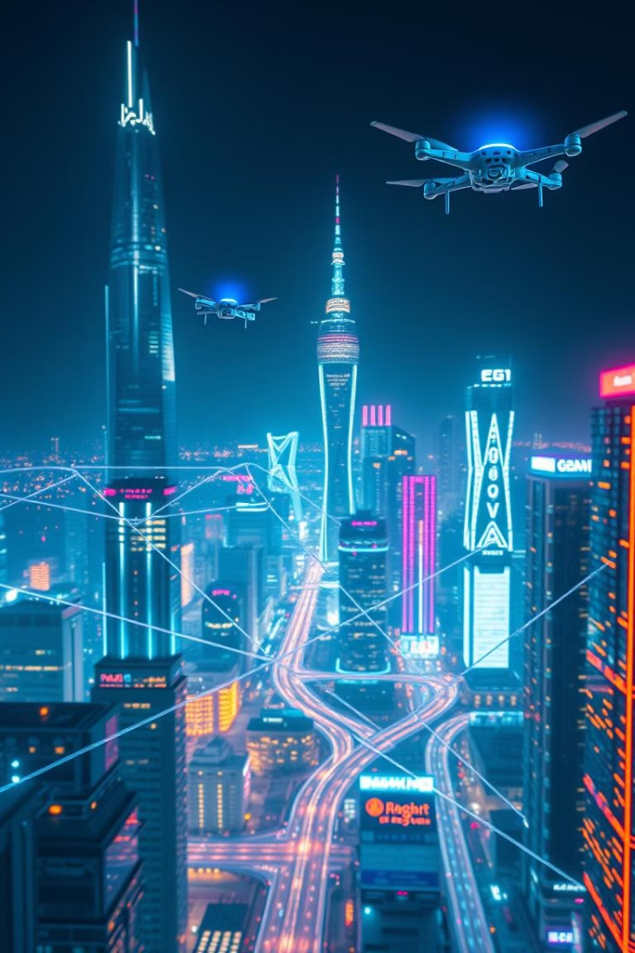

The Internet of Things: Connecting Our World
Welcome to the world of the Internet of Things, where everyday devices come alive, connecting with each other and us through the power of the internet. Prepare to unlock a future of automation, efficiency, and boundless possibilities.
by Muhammad Ibraheem Tahir

Slide 2
What is the Internet of Things?
Definition
Connecting the Physical and Digital
The Internet of Things (IoT) is a network of physical devices, vehicles, buildings, and other items embedded with electronics, software, sensors, actuators, and network connectivity that enable these objects to collect and exchange data. It's about making the world around us smarter.
Imagine a world where your refrigerator can order groceries when you're running low, or your car can warn you about traffic congestion before you even leave the house. This is the potential of IoT.

Slide 3
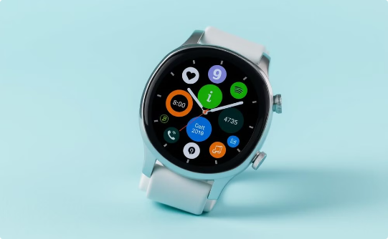
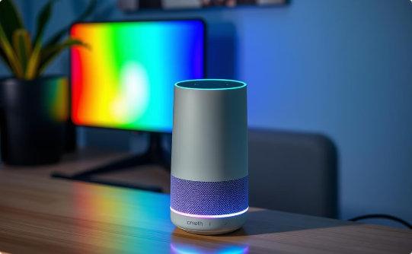
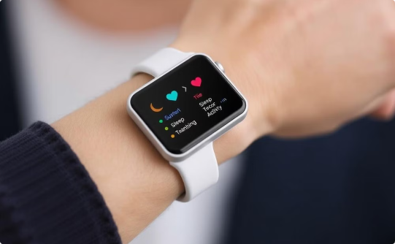
IoT Devices and Applications
Smartwatches
Smart Speakers
Fitness Trackers
Track your fitness, receive notifications, and even make payments.
Control your home, play music, and access information with your voice.
Monitor your steps, calories burned, and sleep patterns.

Slide 4
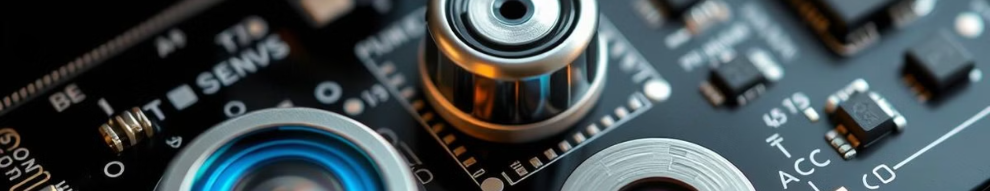
Sensors and Data Collection
1
Gathering Insights
2
Data-Driven Decisions
3
From Temperature to Motion
Sensors are the eyes and ears of IoT devices, collecting data about the environment, our actions, and the world around us.
This data fuels the intelligence of IoT systems, enabling devices to make decisions and automate tasks.
Sensors can measure temperature, light, motion, humidity, and much more, providing a rich understanding of the world.

Slide 5
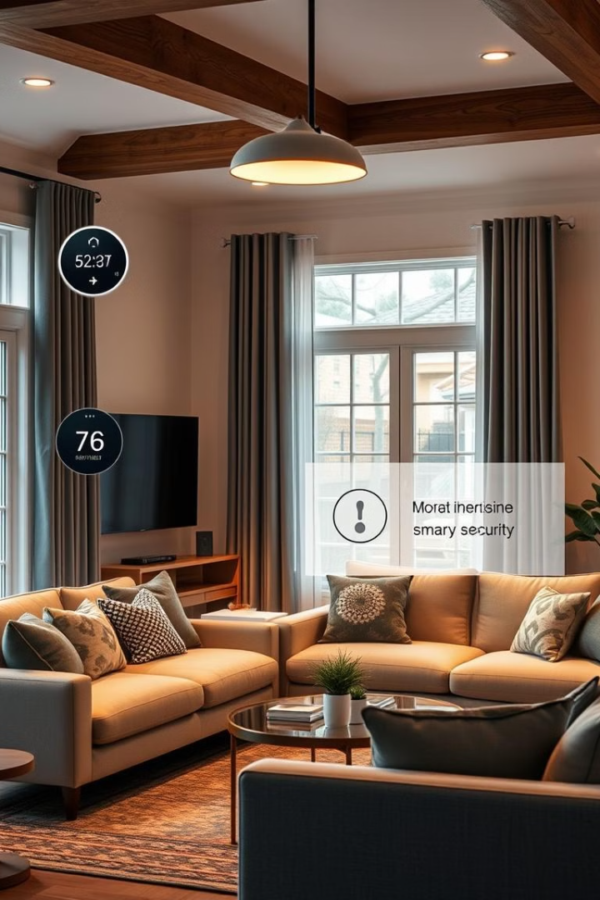



Home Automation and Remote Control
Smart Homes
Remote Monitoring
Control your lights, thermostat, and security system from anywhere.
Check in on your home remotely and receive alerts.
Automated Tasks
Set schedules for lights, appliances, and other devices.

Slide 6



Benefits of IoT
Convenience
1
Simplify your life with automation and remote control.
Efficiency
2
Optimize your operations and save time and resources.
Innovation
3
Unlock new possibilities and drive business growth.

Slide 7
Challenges and Drawbacks of IoT
Security
1
Data breaches and cyberattacks pose a significant risk.
Privacy
2
Collecting personal data raises ethical and legal concerns.
Complexity
3
Deploying and managing large-scale IoT networks can be challenging.

Slide 8

Thank You!

